Slide 1

Multiple Disease Prediction
ML Project (group_8)

Slide 2
TEAM MEMBERS AND ROLES
SL. NO. | NAMES | CONTRIBUTION
1. | ARPAN CHATTERJEE | DECISION TREE CLASSIFIER & SUPPORT VECTOR MACHINE, STREAMLIT DEPLOYMENT
2. | AKASH SINHA | RANDOM FOREST CLASSIFIER, METHODOLOGIES
3. | PRIYANKA MUKHERJEE | LOGISTIC REGRESSION, DATA CLEANING
4. | SAYAN MONDAL | K NEAREST NEIGHBOUR, COMPARISON OF ACCURACY
5. | SATYABRATA BANDYAPADHYAY | NAÏVE BAYES ALGORITHM, PREDICTIONS

Slide 3
PROBLEM STATEMENT:
MULTIPLE DISEASE PREDICTION:
For this Problem Statement, we identified a problem in labs and clinics, that a lot of time is taken for the tests and then to get evaluated by the doctors or specialists from the test, to learn about whether the patient is healthy or the report defines about any disease.
Sometimes the clinic demand lot of charges, for higher number of tests. And Mandatorily a middle-class person cannot afford regular clinical tests, or surveys, due to their high charges.
And, this increases the chances for any healthy individual, who might think he or she is healthy, but may be he has some underlying disease, growing in the non-tested body.
Or sometimes the patient might have the capability to get tested in a clinic but cannot pay the charges of a regular doctor.

Slide 4
SOLUTION
MULTIPLE DISEASE PREDICTION MODEL USING ML:
WE HAVE BUILT AN ML MODEL THAT PREDICTS THE USER HAS SOME KIND OF DISEASE OR NOT.
OUR MODEL IS DEPLOYED USING STREAMLIT AS A WEB APP WITH AN USER FRIENDLY INTERFACE FOR THE PATIENT TO UNDERSTAND.
IT TAKES 20+ PARAMETERS FROM THE USER AND CAN PREDICT AMONG 5+ DISEASE THAT WE HAVE TRAIN OUT MODEL WITH.
AND OUR ACCURACY IS EVEN 100% FOR NOW, SO USERS CAN TRUST OUR MODEL.
WE HAVE USER 5+ ALGORITHMS FOR GETTING THE MOST ACCURATE ONE.

Slide 5

OBJECTIVEs and scope
Personalized Medicine:
Treatment plans based on individual Patient Profile
Early Detection:
Identifying diseases at an Early Stage is more Treatable
Resource Allocation:
Assisting healthcare providers in planning and prioritization
Real Time Prediction:
IRL Prediction for Clinical decision making
Federated Learning:
Decentralized ML for privacy reasons.
PROVIDE ACCESS TO MEDICAL SPECIALIST
ENHANCES QUALITY OF HEALTH CARE
GREAT SIGNIFICANCE IN ICU
Explainable AI: Model Development, Transparent and Understandable Prediction
Federated Learning: Decentralized ML for privacy reasons.
Multi Modal Learning: Training of model, Integration of data, Imaging and accuracy purpose.

Slide 6
methodology
Involves | Key concepts | Steps
Creating Models that can predict the occurrence of various diseases | Data Types ( Clinical Data, Imaging Data, Lifestyle Data, etc. that are available of collected) | Model Selection Tradition ML Models ( Logistic Regression, Decision Tree, etc.) Deep Learning Models, etc.
Large Datasets and sophisticated Algorithms to identify patterns | Feature Engineering ( Extracting features from Raw Data to Train ML models ) | Training and Validation Splitting Data Cross Validation Tuning, etc.
Identify or create apparent Correlations through traditional methods | Labelling ( Multi-Class or Binary Labelling of raw data for Supervised Learning) | Evaluation Metrices Accuracy Precision and Recall F1 Score, etc.

Slide 7
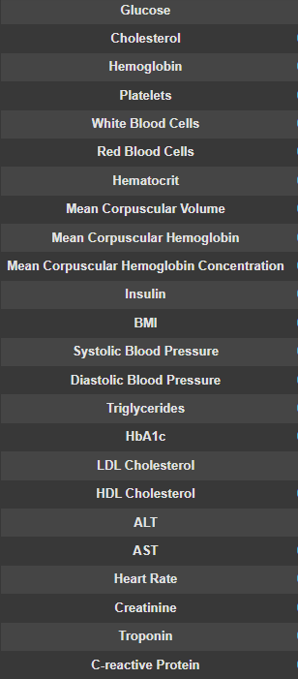
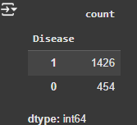

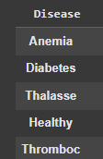
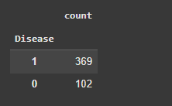
DATA DESCRIPTION
PREDICTION

Slide 8
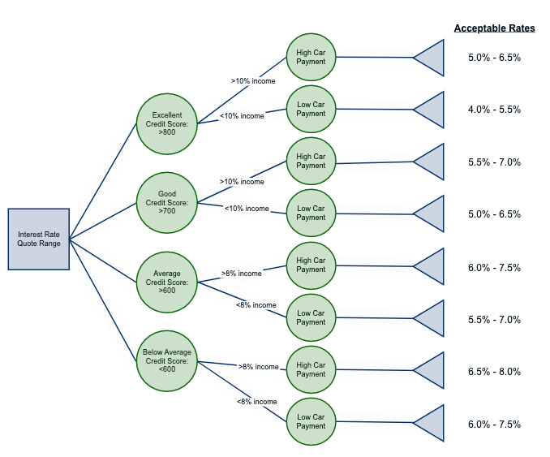
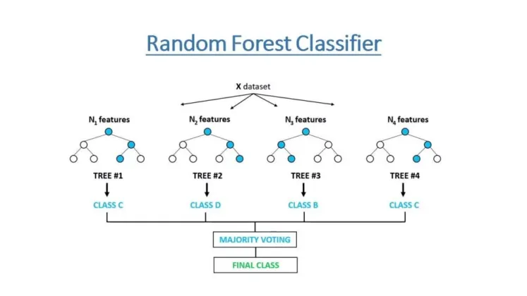
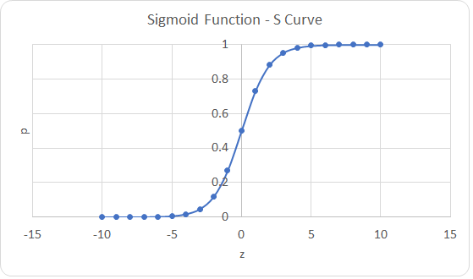
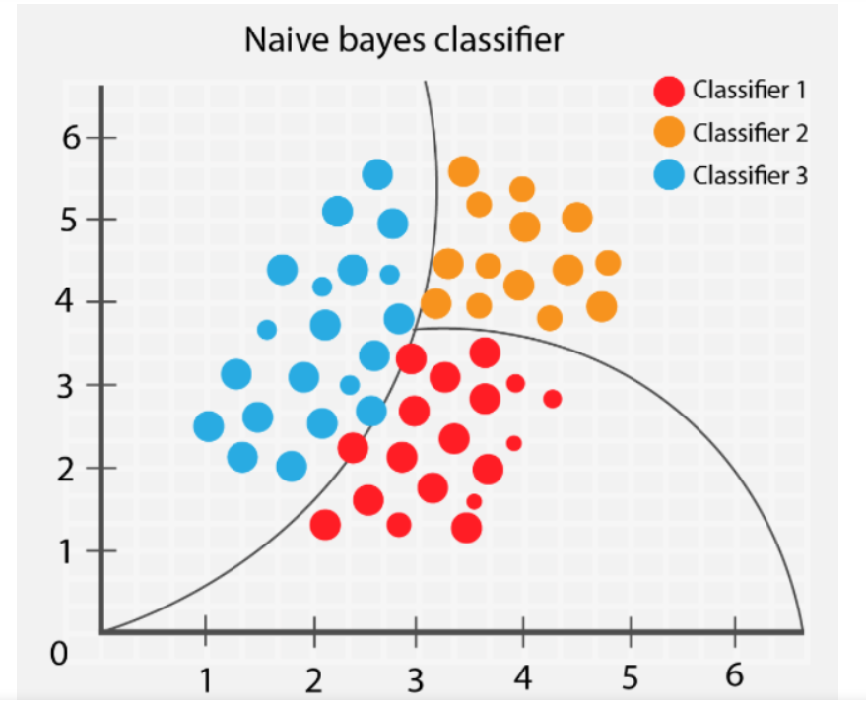
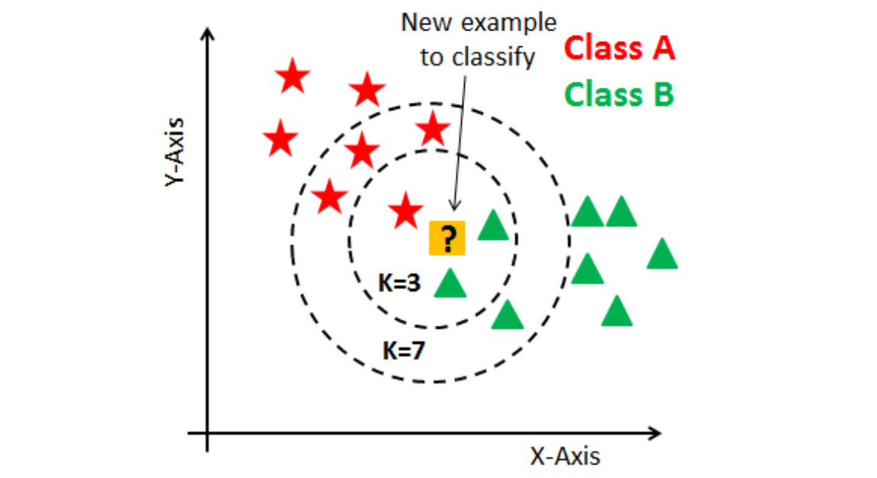
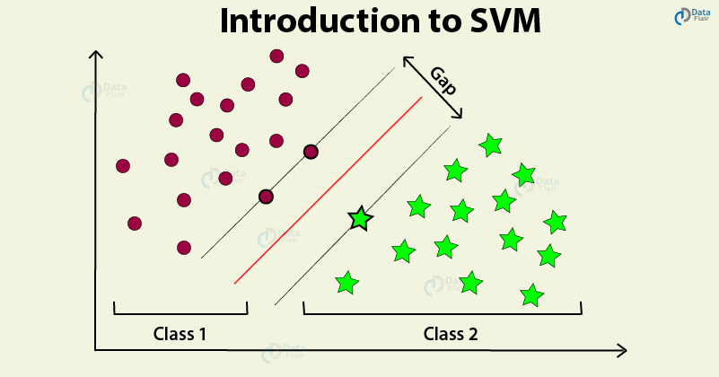
MODELS USED

Slide 9
RANDOM FOREST
The random forest algorithm is a machine learning technique that uses multiple decision trees to solve problems like classification and regression
The algorithm creates many decision trees,
The output of the random forest is the class or value that most of the trees select.
Random Forest is an ensemble learning algorithm that combines multiple decision trees to improve prediction accuracy.
By generating numerous decision trees, Random Forest reduces overfitting and increases robustness.
Each decision tree analyzes a subset of features, and the algorithm aggregates their predictions to produce a final output.
This approach excels in handling high-dimensional data and complex interactions.
Random Forest is used for both classification and regression tasks. It's known for its high accuracy and ability to handle complex datasets. In our model, it's used for disease classification.
Random Forest builds multiple decision trees and combines their predictions to make a final decision. This ensemble approach reduces overfitting and improves generalization.

Slide 10
LOGISTIC REGRESSION
Logistic Regression is used for binary classification, which means predicting one of two possible outcomes. In this case, it's used to predict whether a patient is "Healthy" or has a "Disease" (which is a combined category for various diseases in our dataset).
Logistic Regression estimates the probability of an instance belonging to a particular class.
Logistic Regression is a supervised learning algorithm used for binary classification problems, predicting the probability of an event occurring.
It models the probability of an event based on one or more predictor variables using a logistic function, mapping probabilities between 0 and 1.
The algorithm provides interpretable results, including odds ratios and coefficients that represent the change in log odds for a one-unit change in the predictor variable.
Logistic Regression has various applications, including credit risk assessment, medical diagnosis, and customer churn prediction.
Its advantages include handling categorical variables, binary classification, and providing interpretable results. Common evaluation metrics for Logistic Regression include accuracy, precision, recall, F1-score, and Area Under the Receiver Operating Characteristic Curve (AUC-ROC).

Slide 11
NAÏVE BAYES
Naive Bayes is a supervised learning algorithm used for classification problems, leveraging Bayes' theorem to predict probabilities.
It assumes independence between features, simplifying calculations and improving scalability.
Naive Bayes excels in handling high-dimensional data and categorical variables. The algorithm calculates posterior probabilities by multiplying prior probabilities and likelihoods.
Naive Bayes has three main types: Multinomial Naive Bayes for multi class problems, Bernoulli Naive Bayes for binary features, and Gaussian Naive Bayes for continuous features.
Naive Bayes is useful in dependent events in terms of conditional Probability.
It is actually the Bayes theorem that determines the Multiplication of dependent Events.
It is called Naïve because it assumes that the occurrence of a certain feature is independent of the occurrence of other features. Such as if the fruit is identified on the bases of color, shape, and taste, then red, spherical, and sweet fruit is recognized as an apple. Hence each feature individually contributes to identify that it is an apple without depending on each other.
It is called Bayes because it depends on the principle of Bayes Theorem.

Slide 12
KNN
KNN is used for classification and regression. It's a non-parametric algorithm, meaning it doesn't make assumptions about the underlying data distribution. In our model, it's used for disease classification.
KNN classifies an instance based on the classes of its nearest neighbors in the feature space. The number of neighbors to consider is determined by the 'k' value.4. Decision Tree
The k-nearest neighbors (KNN) algorithm is a non-parametric, supervised learning classifier, which uses proximity to make classifications or predictions about the grouping of an individual data point.
It is one of the popular and simplest classification and regression classifiers used in machine learning today
KNN (k-nearest neighbors) is known as a "lazy learning" technique because it does not explicitly learn a model from the training data.
Instead, it stores the entire training dataset and waits until a new data point is presented for classification or regression.
KNN is one of the most basic yet essential classification algorithms in machine learning.
It belongs to the supervised learning domain and finds intense application in pattern recognition, data mining, and intrusion detection.
It is widely disposable in real-life scenarios since it is non-parametric, meaning it does not make any underlying assumptions about the distribution of data (as opposed to other algorithms such as GMM, which assume a Gaussian distribution of the given data).
We are given some prior data (also called training data), which classifies coordinates into groups identified by an attribute.

Slide 13
DECISION TREE
Decision Trees are used for classification and regression.
They are easy to interpret and visualize. In our model, it's used for disease classification.
Decision Trees create a tree-like structure to make decisions based on a series of rules inferred from the features.
Each node represents a feature, and branches represent possible values of that feature.
A decision tree is a flowchart-like structure used to make decisions or predictions.
It consists of nodes representing decisions or tests on attributes, branches representing the outcome of these decisions, and leaf nodes representing final outcomes or predictions.
Each internal node corresponds to a test on an attribute, each branch corresponds to the result of the test, and each leaf node corresponds to a class label or a continuous value.

Slide 14
SVM
Support Vector Machines (SVM) are supervised learning algorithms that optimize hyperplanes to separate classes.
SVM finds the optimal boundary between classes by maximizing the margin, or distance, between support vectors.
This algorithm excels in handling non-linear relationships and high-dimensional data.
SVM can also handle non-linear kernels, enabling effective classification.
SVM is used for classification and regression.
It's known for its ability to handle high-dimensional data and find complex decision boundaries.
In our model, it's used for disease classification.
SVM finds the best hyperplane that separates data points into different classes with the largest margin.
It can use different kernels to handle non-linearly separable data.

Slide 15
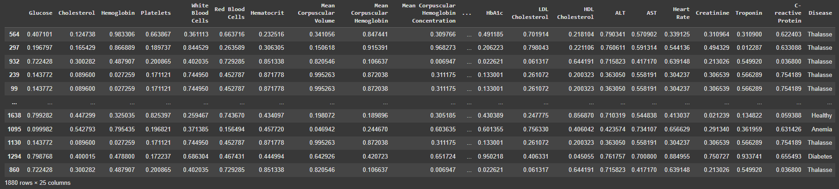
Dataset
Printing of the head values of testing and training data.
Both have different set of values from the provided dataset.

Slide 16
NUMPY: Numpy is the primary way to handle matrices and vectors in python. Numpy can be used to model a whole dataset using vectors/matrices.
MATPLOTLIB AND SEABORN: For plotting bargraphs, scatterplots, and many more
SMOTE is a sub-module imported from imblearn package, it is a statistical technique for increasing the no of cases in dataset in a balanced way.
Sklearn is the model or a package that provides us different sub-modules, or classes that allows us to train, test and predict data, find accuracy, precision and other scores.
Import warnings warnings.filterwarnings(“ignore”): This line imports the WARNING module, which is a built-in Python module for handling warning messages. This is the crucial part. It tells Python to ignore all warning messages that might be generated during the execution of your code.
PANDAS:
Pandas is chiefly used in ML in form of Dataframes.
Pandas allow to import datasets in various formats like .csv, etc.
from re import A:
This line imports ‘A’ constant from regular expression operations module in Python, such as pattern matching in strings.

Slide 17
READ AND FED
SHAPE OF THE DATA
The Shape of the Train and Test data defines how many data from the data has been fed for training and what is the number of data it will be tested on.
Here we have taken 80% of data for training the model and 20% of data for the testing procedures.
SPLIT in Test and Train
Here we can read the data from the dataset and use it for training and testing of the algorithm.
The dataset is called and read using a pandas function pd.read_csv(‘filename.csv’) and filename is the path to where the dataset is saved in drive
Using train_test_split function we are splitting the inserted dataset “file.csv” into 80:20 portion.
The Train data will be trained to the algorithm, and Test data will be tested after being trained by the dataset, to ensure the model properly works.

Slide 18
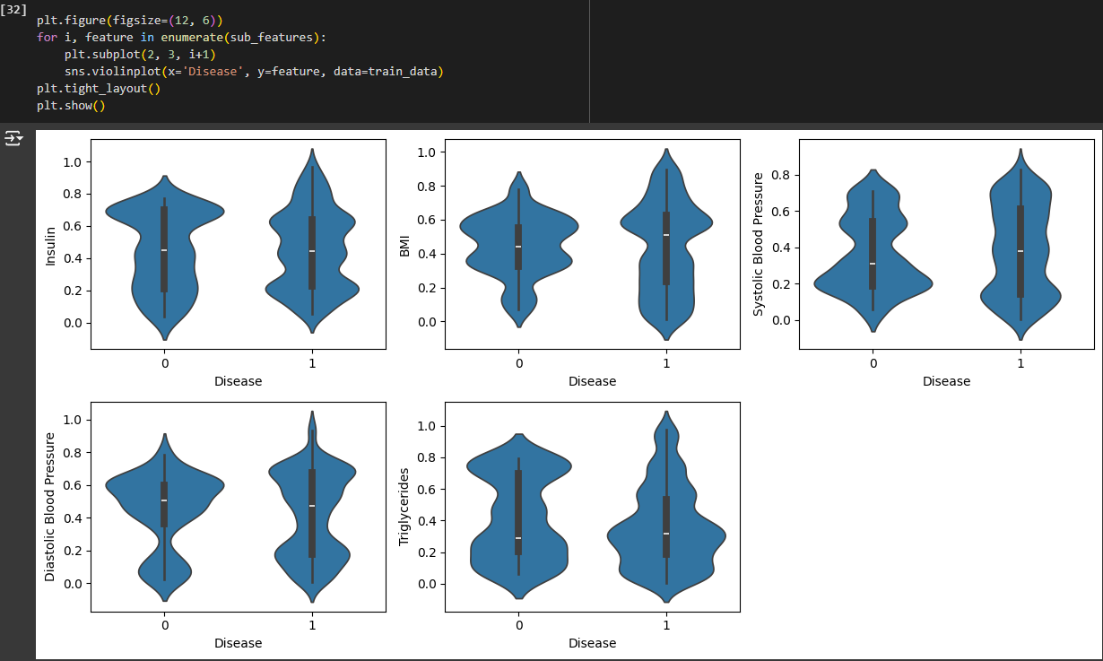
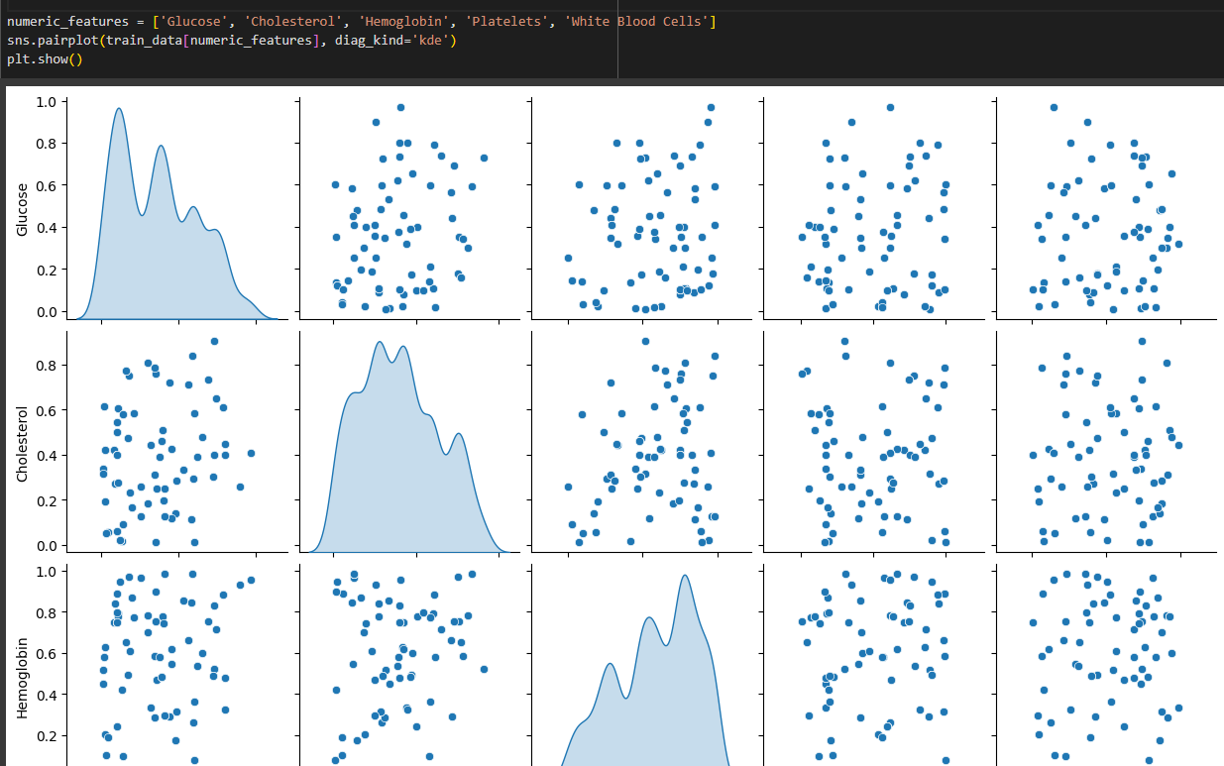
VIOLIN PLOT AND PAIR PLOT

Slide 19
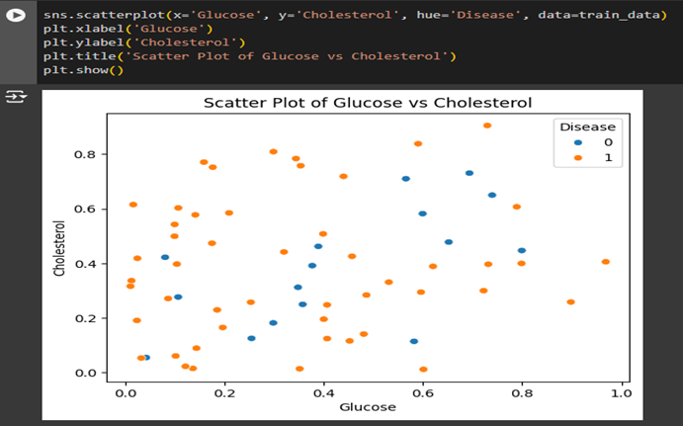
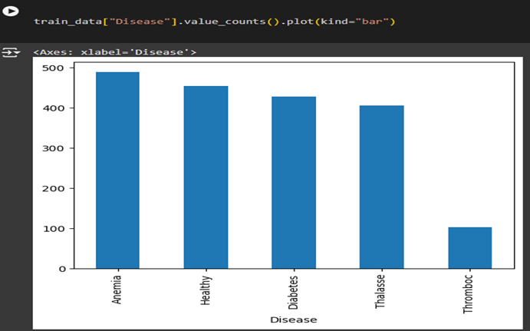
SCATTER PLOT AND BAR PLOT

Slide 20
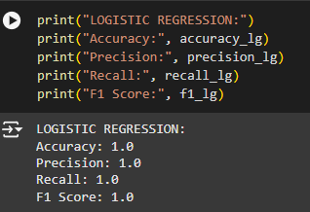
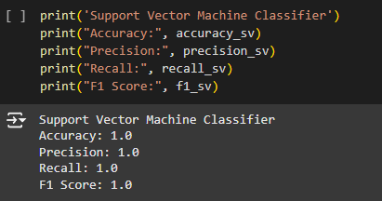
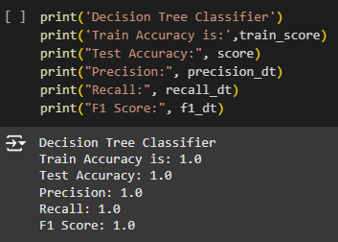
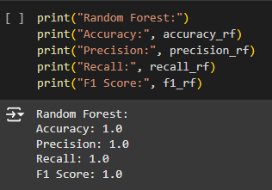
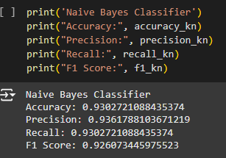
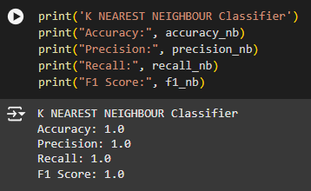
Metrices Check
Finally, we get to know about the different Scores of different algorithm that was fit into our dataset, and which one fits the best in our model, by comparing their metrices on the fitted dataset.

Slide 21
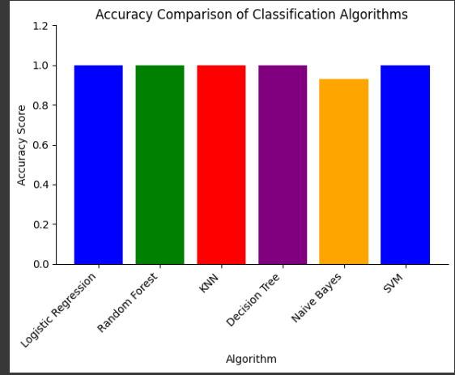
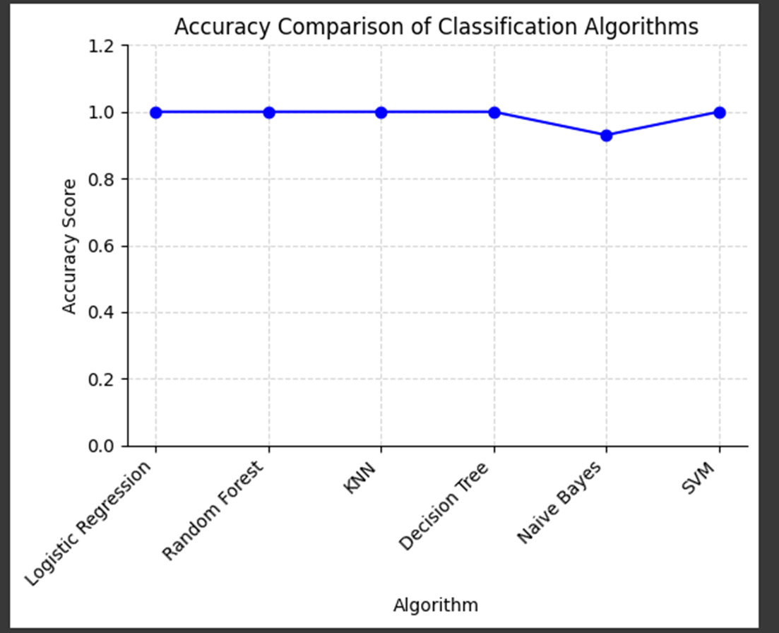
COMPARISON: HERE WE ARE COMPARING THE ACCURACY SCORES AND CHECKING WHICH ONE MIGHT BE THE BEST SUITED FOR OUR PREDICTION MODEL.

Slide 22
CONCLUSION
EXPERIMENTS ARE CONDUCTED IN ORDER TO EVALUATE THE PERFORMANCE OF THE PROPOSED SYSTEM
For the given symptoms using seven types of supervised machine learning algo, the systems predicts any kind of disease
Then the predicted disease list forward to the doctor
At last doctor choose the correct disease from forwarded list and suggest the required treatment

